Slide 1
Career Pathways and IPE Training for New Counselors
Jessi Blosser, DARS
Kate Kaegi, DARS

Slide 2
Poll: How do you feel about creating plans??????
Notes:
Put your thoughts in the comments section.

Slide 3
The Perfect IPE….
Notes:
Living document/ evergreen document/ dynamic document
Continually edited and updates.

Slide 4
Training Objectives
By participating today, you should be able to:
Describe why occupational clusters and career pathways are important to VR.
Identify career pathways and how to integrate the concept into VR process.
Expand your consideration of support services and how they can increase an individual’s career options/considerations.

Slide 5
CPID and WIOA

Slide 6
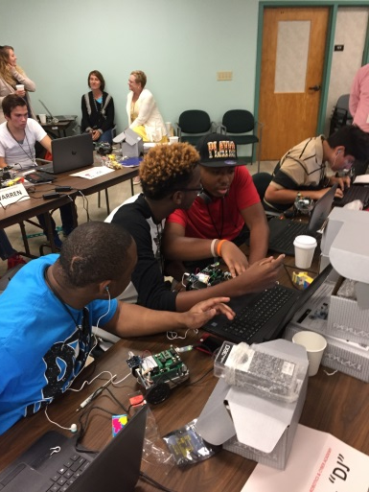
It’s Not Just a Project…
There is a much larger umbrella under which CPID exists
Career Pathways = Strong Vocational Rehabilitation
https://careerpathways.workforcegps.org/resources/2016/10/20/10/11/Enhanced_Career_Pathways_Toolkit
Notes:
Career Pathways are a new way of looking at employment and changes how the system (and VR as a part of that system) looks at accessing employment.

Slide 7
Some Highlights
"WIOA provides … an integrated, job-driven, public workforce system that links diverse talent to businesses.
This revitalized workforce system includes three critical hallmarks of excellence:
The needs of business and workers drive workforce solutions;
American Job Centers work with consumers and businesses; and
The workforce system supports strong regional economies and plays an active role in community and workforce development.
Notes:
What does this mean to you?
Resources – they know what's in demand – can only pay for training in demand
other resources you may not know about (other trainings – intellectual point) Hampton – listing of staffing agencies
contact with business – job fairs, resume work, access to computers
help with funding for training
IRT’s – indiv resource teams – can be time consuming and hard to schedule

Slide 8
Sector Strategies
“Sector strategies are partnerships of employers within one industry that bring government, education, training, economic development, labor, and community organizations together to focus on the workforce needs of an industry within a regional labor market. At the state level, they are policies and investments that support the development of local sector partnerships. Sector strategies can do the following:
Address current and emerging skills gap
Provide a means to engage directly with industry across traditional boundaries
Better align state programs and resources serving employers and workers”
Source: National Governor’s Association
Notes:
Better connections with industry’s and Worker’s needs yield better outcomes. When employers find effective ways to work together with education and training providers they improve their bottom line through creating a pipeline of employees who are specifically trained and matched to their jobs. Our project worked to create a demand driven Certified Logistics Technician Program in the Shenandoah Valley only after holding a Demand Side meeting to identify the skills employers needed. These businesses stated that If we can prepare workers and increase retention, they were willing to work with us by giving interviews to our successful graduates. We aligned with local adult education, VCCS and workforce partners to create this new entry point on the modern manufacturing career pathway. We offered technical supports with assistive technology and universal design for learning.

Slide 9
Examples
Partnering with Adult Education and Hampton University to provide CLA Certification, OSHA 10, Forklift and Digital literacy.
Working with Workforce to refer IWD that are in delayed status.
Developing IRTs with partners to ensure the best outcome for IWD.
Collaborating with the Community College for non-credit training and Fast Forward Funds
Notes:
What does this mean to you?
Resources – they know whats in demand – can only pay for training in demand
other resources you may not know about (other trainings – intellectual point) Hampton – listing of staffing agencies
contact with business – job fairs, resume work, access to computers
help with funding for training
IRT’s – indiv resource teams – can be time consuming and hard to schedule

Slide 10
Career Pathways and Clusters

Slide 11
How Do Clusters and Pathways relate to my work as a Counselor?
Funding
Local Labor Market
Transferability of Skills
Additional options fall within the
Candidates interest
Manufacturing Cluster
Production Pathway
Logistics and Inventory Pathway
Maintenance Pathway
Notes:
Career Clusters help students investigate careers and design their courses of study to advance their career goals. For this reason, Virginia has adopted the nationally accepted structure of career clusters, career pathways and sample career specialties or occupations.
A Career Cluster is a grouping of occupations and broad industries based on commonalities. Within each career cluster, there are multiple career pathways that represent a common set of skills and knowledge, both academic and technical, necessary to pursue a full range of career opportunities within that pathway – ranging from entry level to management, including technical and professional career specialties. Based on the skills sets taught, all CTE (career and technical education) courses are aligned with one or more career clusters and career pathways.

Slide 12
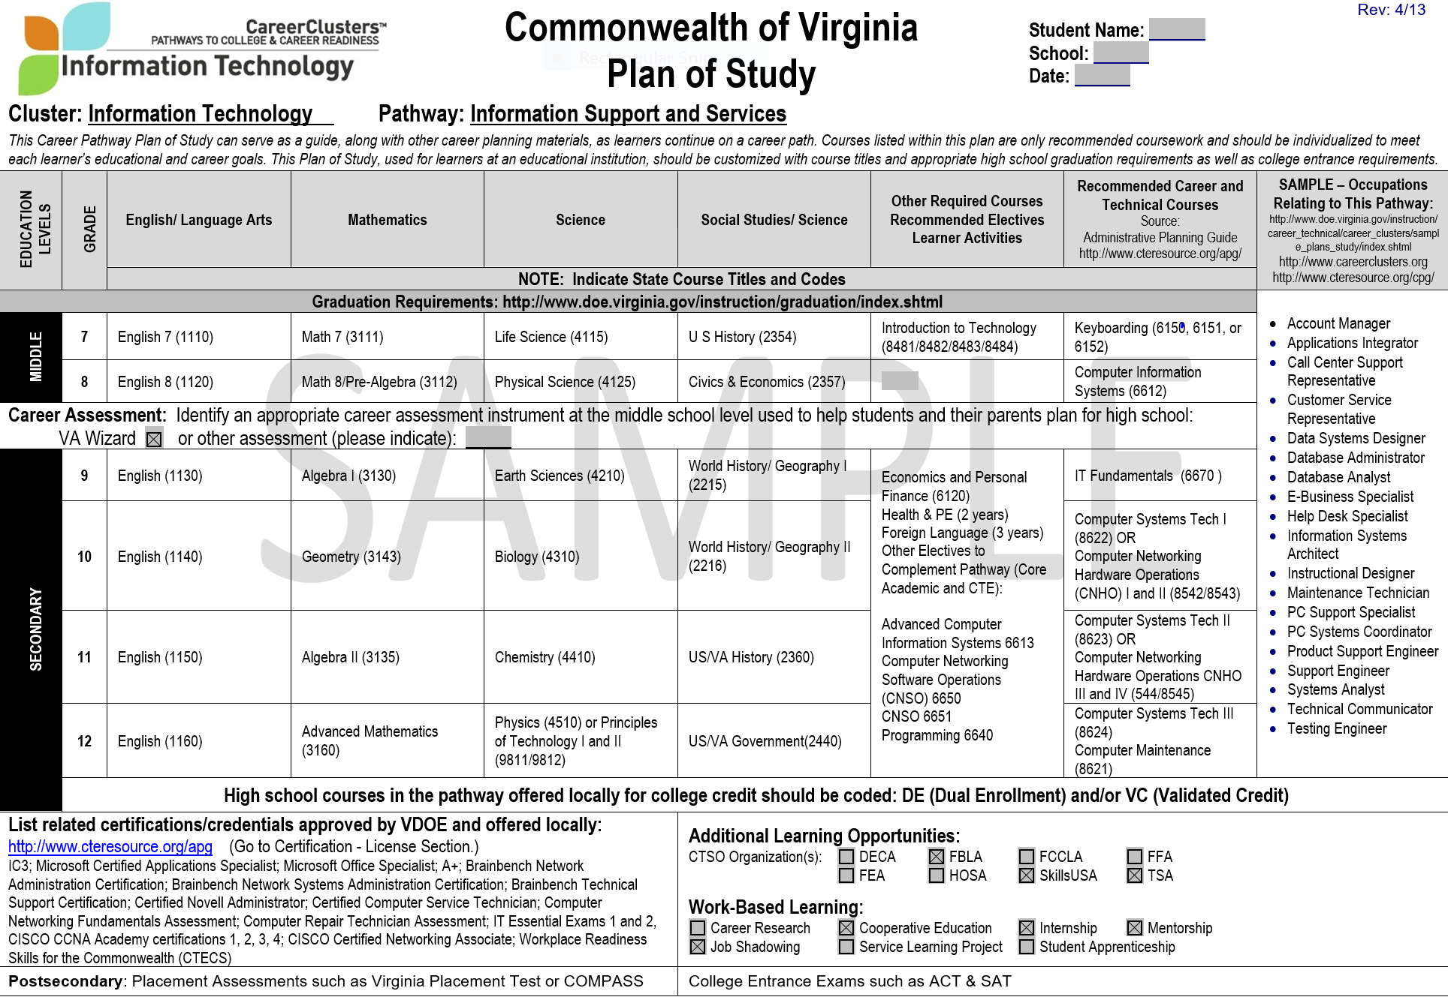
Notes:
The Career and technical education page through DOE is an excellent resource.

Slide 13
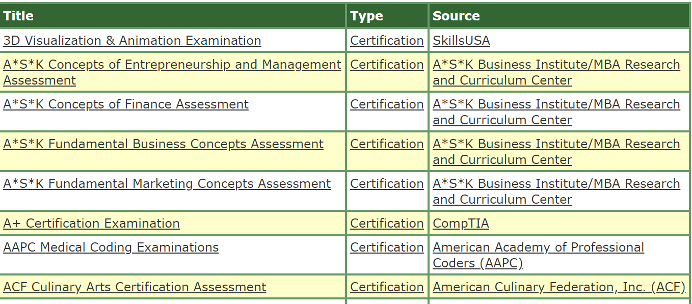
Notes:
Credentials through the DOE

Slide 14
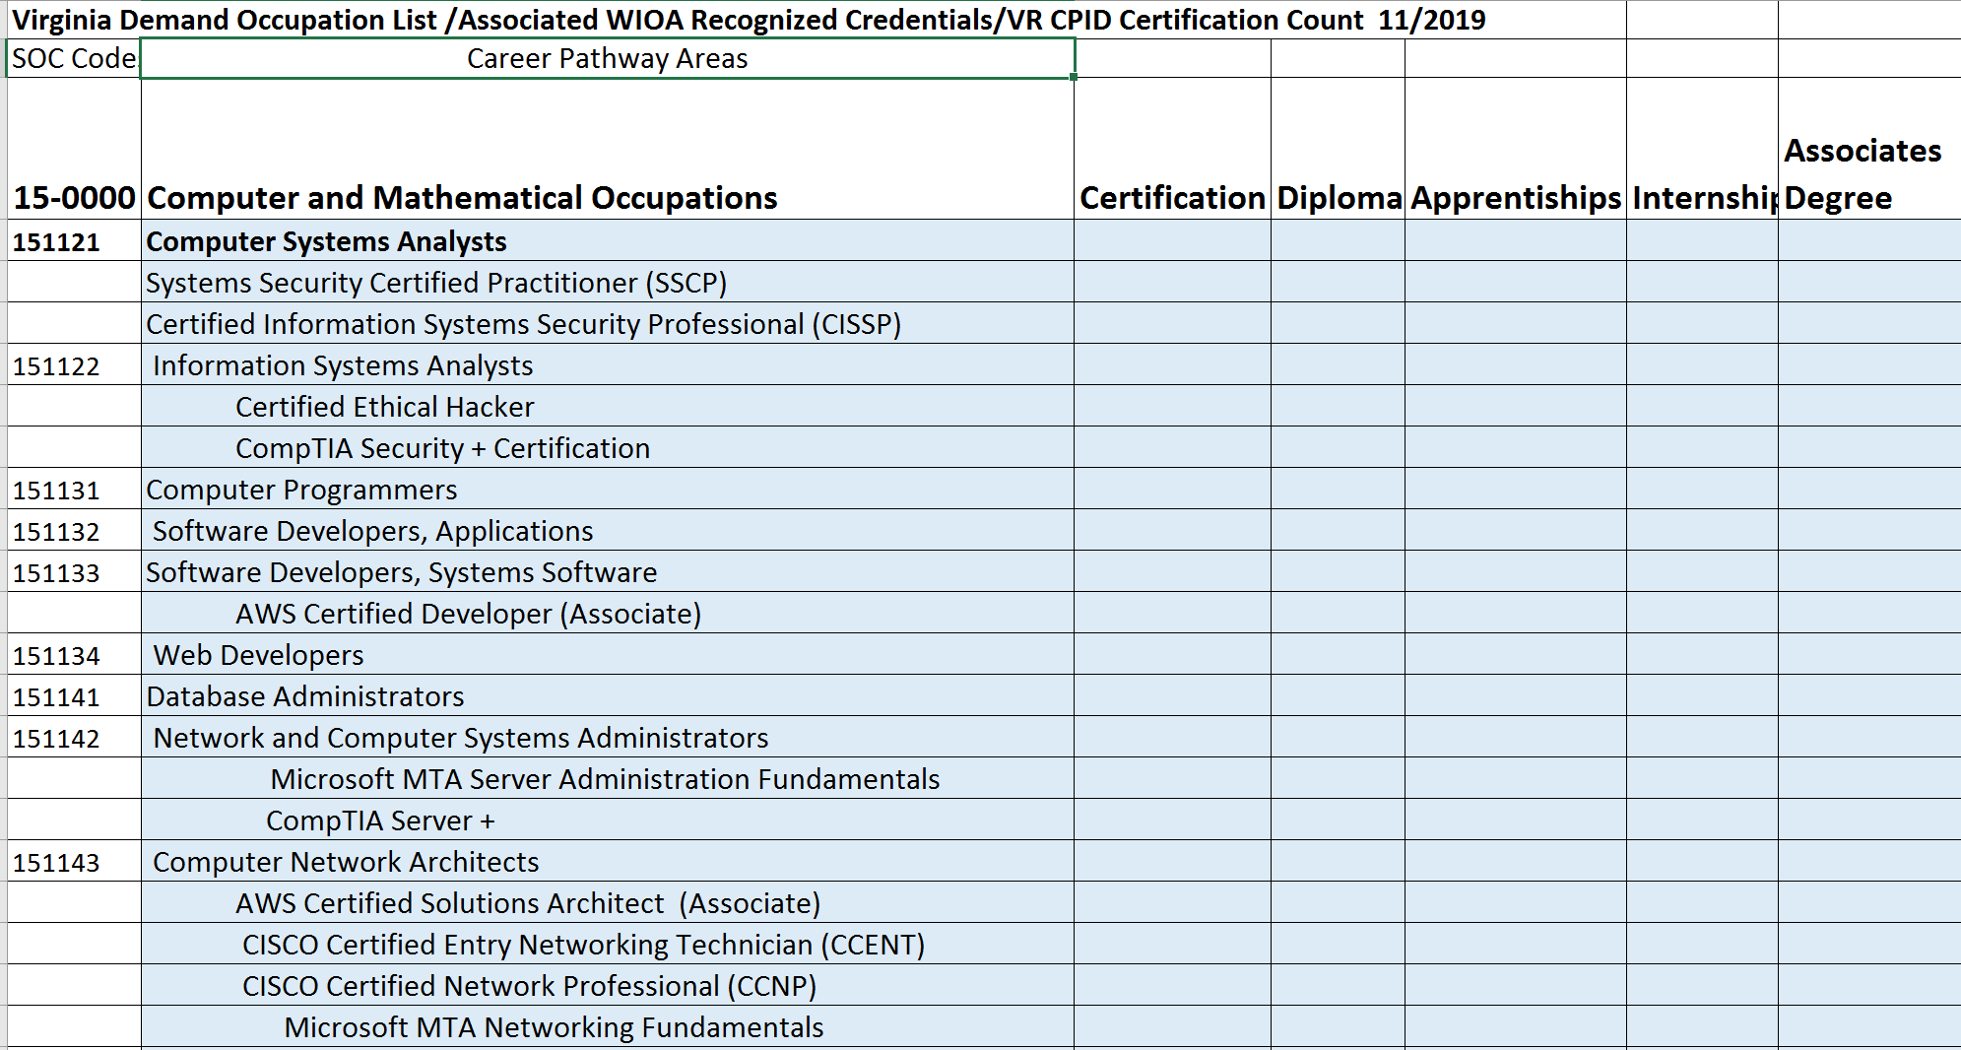
Notes:
CPID is working on a list that combines the VA Demand Occupation List
The associated WIOA Recognized Credentials
WWRC
Will also include the Community colleges and the Fast forward occupations that are in demand.
These will vary by school.

Slide 15
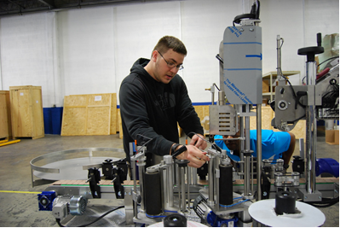
Why Focus on Specific CPID Pathways?
Manufacturing
Logistics
IT
Automotive
Trades
Healthcare
Notes:
All were chosen based on labor market demand, growth potential and potential wage earnings.
Logistics – just saw advertisement for Walmart distribution for freight handler starting at 16.15 with benefits.

Slide 16
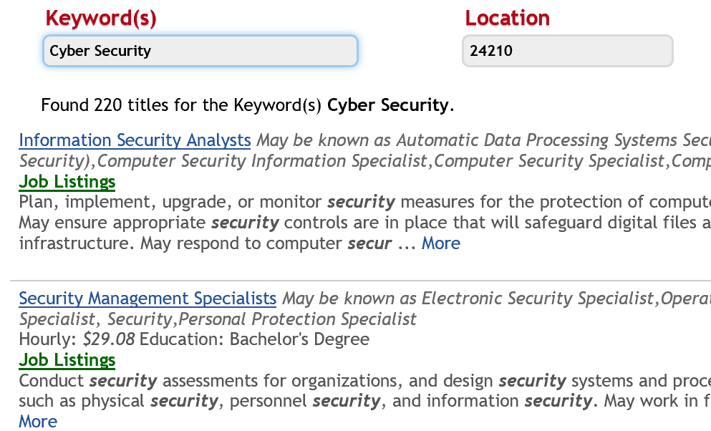
Career Index Plus
A good place to start to consider careers and LMI
Career Index Plus
Notes:
Job Search: We are excited to announce that we have partnered with the National Labor Exchange (NLx) for a job feed. NLx is the hub for posting all state and federal as well as a host of private jobs. These jobs postings are extremely well maintained with few duplicates and O*NET coded (more accurate than Indeed Jobs).
So when you look at Jobs, you now have two tabs. The first is for the NLx jobs National Labor Exchange , and the second for Indeed Jobs.
Explore Opportunities On the home page, click the green Explore Opportunities button. Select a list of local job opportunities you would like to see and apply filters if you like. That will present you with a list of jobs which you can print or download to Excel.
Occupational Requirements We have added Occupational Requirements from the Bureau of Labor Statistics. This data includes detailed requirements for about 400 occupations. To access, go to the main occupational information page, click the "Suitability" tab and then the "Requirements" tab.
Short Term Labor Market Projections for 50 states Apprenticeships New Help Docs You can now access a growing library of help docs (including this document) from its own button at the top of every screen.

Slide 17
Career Index Plus

Slide 18
We Have a Potential Goal. Can CPID Help?
Some of the Who and What Functions or Counselor FAQ’s

Slide 19
How do I know who is appropriate for which Pathway/Certification?
Assessment/ Education
Pathway | Credential | Publisher | Academics
Advanced Manufacturing | Manufacturing Specialist | MSI | Silver CRC (8th grade reading and math)
 | Manufacturing Technician One | MSI | Silver CRC (8th grade reading and math)
Logistics | Certified Logistics Associate | MSSC | 5th grade with supports
 | Certified Logistics Technician | MSSC | 9th grade
Information Systems | A+ | CISCO | 10th grade
 | Security + | CISCO | 10th grade
 | Network + | CISCO | 10th grade
Notes:
Manuf Handling – 2nd grade
CLA – 4-5th with supports
CLT – 5 and 6th
IT – 10th
Production – 4th
Manuf – 8th/ silver CRC
Plugged in
As long as students test at a level that we can serve in adult education programs (below a 12.9), we can serve them in PluggedInVA.
The quick answer to this question is never. One of the primary academic goals of PluggedInVA programs is to prepare students for success in higher education, should they chose to pursue it. We need to ensure that our students will not be required to take remedial development education courses at community colleges. These courses cost money and do not count toward any degrees. One of the adult education program's responsibilities in PluggedInVA is to strengthen students' basic skills, and PluggedInVA models should never include development education courses at the post-secondary institution.
PluggedInVA is a rigorous and intensive program that demands motivation and dedication. Successful students will possess a certain skill level and a willingness to work hard during the six-month program. For this reason, a thorough intake process is essential in ensuring that the students who are chosen to participate are ready to do so. Using a test of basic skills, like GAIN or TABE, students should test at the ninth grade level in reading and math. Additionally, a career interest or aptitude test is recommended to help students get an idea of where their strengths lie. An interview should also be held to determine a student's interest and to determine their capacity to complete the program. If they have personal barriers, like childcare or transportation or an ailing family member, and the program is unable to assist him or her, suggesting a less demanding program is recommended. Some programs also use letters of recommendation from the community or from students' places of work, and the Virginia Placement Test (VPT) has been used to determine a student's readiness to complete post-secondary work.
Program Manager
Rachel Morrissey
rmorriss@rvaschools.net
(804)780-6039
-----------------------------------------------------------------------------
Disabilities and the Adult Learner online course 6 weeks – 24 CRC credits
______________________________________________________________________________________

Slide 20
Progress Measures

Slide 21
CP Flowchart

Slide 22
Progress Measure Examples
Young man interested in Welding because his biological father is a welder (Autism and Anxiety)
Exploratory Progress Measure
Suitability Progress Measure
Feasibility Progress Measure
Training Progress Measure
Employment Progress Measure
Other Progress Measures
Notes:
Feasibility – state or degree of being easily or conveniently done
Suitability – the quality of being right or appropriate for a particular person/purpose/situation

Slide 23
Progress Measure Examples
Women who recently received her degree in Special Education is now interested in IT (Mental Health and Anxiety)
Exploratory Progress Measure
Suitability Progress Measure
Feasibility Progress Measure
Training Progress Measure
Employment Progress Measure
Other Progress Measures
Notes:
Feasibility – state or degree of being easily or conveniently done
Suitability – the quality of being right or appropriate for a particular person/purpose/situation

Slide 24
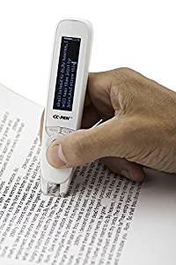
Case Study
2o year old man with learning disabilities and lack of confidence
Worked at Food Lion with a family member
Was referred to MTT class at WWRC and did well with accommodations of reading software
Passed OSHA 10, Silver CRC, and first manufacturing test but failed the second test 2 time
Came back to WWRC for individual tutoring and passed on the third time.
Went back to work at Food Lion due to being overwhelmed about a new job.
Was encouraged to apply for job at one of the places he toured, and was hired!
AT for the job was a reading pen and talking tape measure. Did not end up needing the accommodations due to Lean Manufacturing as the job was organized in such a manner that he was able to be successful!

Slide 25
Who can help you create a Strong IPE?
Candidate
Business Development Managers/Placement Specialists
Occupational Therapist/AT Specialist
Vocational Evaluators
Instructors
Community Partners – Workforce/Adult Education/VEC
Family
Mental Health/ Counselors/ Medical Team

Slide 26
VR Supporting Services

Slide 27
Support for Training
Supports for passing certification process: Providing the correct accommodations for the testing process - more time, test read aloud – or reading software, calculator, retakes; Peer group support and study sessions; additional time in class.
Behavioral Supports for ADHD, Autism, Mental Health: Evaluation and treatment / medication to assist with behaviors that interfere with class work / work potential
Sensory processing needs: Sensory processing evaluation, trial of sensory AT, adjust schedules or routines to accommodate needs, incorporating changes from school to work.
Tutoring: provided by Adult Ed or WWRC teachers, and / or classroom instructors
Notes:
Certification – training is shorter need to get accommodations in motion ASAP. This is when a good relationship with the training provider is helpful.

Slide 28
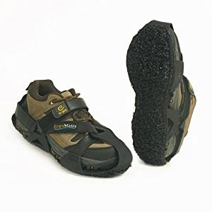
Assistive Technology
Loaner Assistive Technology: CPID has a loaner library for participates in the program and beyond.
Loaner items available for Counselors/instructors/partners
CPID has investigated AT specifically for manufacturing.
Previous need for AT is now filled due to lean manufacturing and good ergonomics

Slide 29
Resources
Cochrane Database Cochrane Reviews
CTE Academic and Career Plans of Study
CTE Credentials
CIP Career Index Plus
Explore VR Website
Explore VR IPE Section
Notes:
Cochrane Clinical Answers (CCAs) provide a readable, digestible, clinically-focused entry point to rigorous research from Cochrane Reviews. They are designed to be actionable and to inform point-of-care decision-making. Each CCA contains a clinical question, a short answer, and data for the outcomes from the Cochrane Review deemed most relevant to practicing healthcare professionals, our target audience. The evidence is displayed in a user-friendly tabulated format that includes narratives, data, and links to graphics. Cochrane Clinical Answers were developed by Cochrane Innovations and Wiley.
Explore VR has some great info on LMI – They also have specific sections for VR counselors – great resource

Slide 30
Questions

